Slide 1
Thrive Rural Wisconsin
Informational Webinar
3 January 2024

Slide 2
Thrive Rural Wisconsin
Todays Agenda
40 minutes presentation on Thrive Rural Wisconsin
Program information
Eligibility and submission process
Technical and Financial Assistance information
20 minutes Question and Answer
During the presentation you may type your questions in the chat

Slide 3
Thrive Rural Wisconsin
Free technical assistance and project management support for 10 rural and Tribal communities to advance local projects.
Opportunity to build collaboration between local economic development partners to achieve common goals.
Access to grant support that can prepare specific projects for state & federal funding opportunities.
Inform trainings and toolkits that the Office of Rural Prosperity will offer to support key technical issues, resources navigation, and capacity building challenges that Tribal and rural communities face.
Strengthen financial and organizational policies and procedures to accept and report on state & federal funding.

Slide 4
Eligibility for Technical Assistance
County economic development organizations
Nonprofits
Tribal organizations
Based in communities of 10,000 people or fewer are eligible to apply for the Thrive Rural Wisconsin initiative, so long as they are not located in a county that contains a Metropolitan Statistical Area (i.e., an urban area of 50,000 or more inhabitants).
The selection process will give priority to Rural communities and organizations located in a county that appears on the FY24 Wisconsin Distressed Counties List.

Slide 5
Priority Areas
Communities must propose a project that advances at least one of the Thrive Rural Wisconsin focus areas:
Community-based economic development
Small business development
Rural housing
Community facilities
Sustainable energy projects
Organizational and financial management

Slide 6
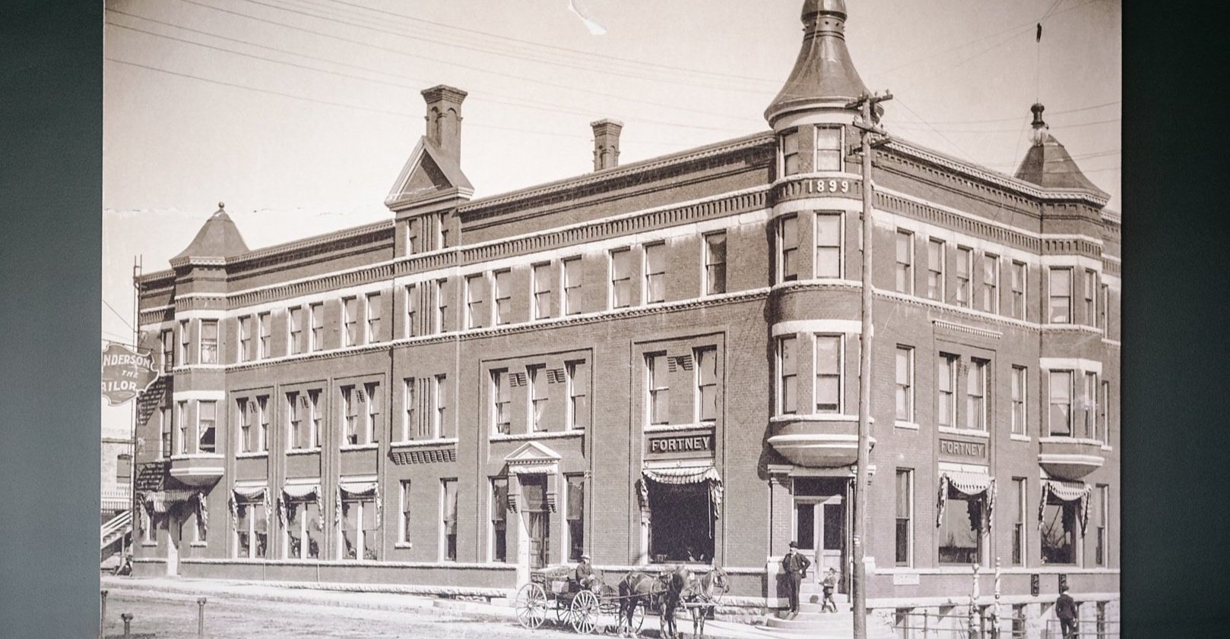
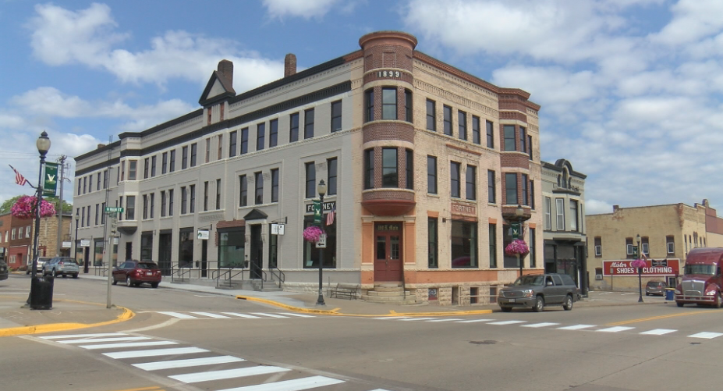
Community-based economic development
Economic development that prioritizes economic well-being and quality of life in a community. This approach engages community members in identifying issues and creating solutions the improve the vibrancy of their communities.
WEDC Community Development Investment Grant (CDI) - Hotel Fortney in Viroqua, WI
The Fortney Hotel building is the most iconic building in downtown and was in a state of disrepair, having served as single room occupancy apartments for the last two decades. New owners purchased the building, stabilized the structure and re-opened the first floor commercial spaces with five retail tenants. A $250,000 CDI grant from WEDC assisted with renovations of the upper floor spaces to create a boutique hotel space with 14 rooms. The City is contributing $213,000 in TIF funds towards this phase the project and contributed to the initial stabilization work.
Image retrieved on 1-2-24 from: https://www.hotelfortney.com/story
Image retrieved on 1-2-24 from: https://www.wxow.com/news/daybreak/past-present-mesh-to-breathe-life-into-the-historic-fortney/article_7f75d469-29de-511f-9f45-80035ab19b85.html

Slide 7
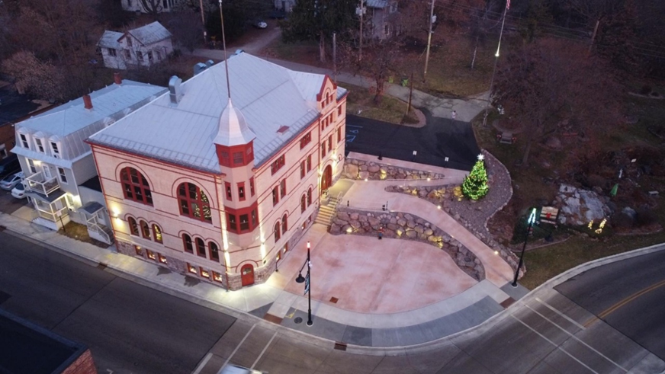
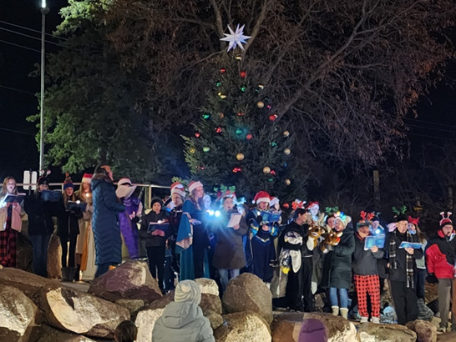
Community-based economic development
WEDC Vibrant Spaces Grant, Danes Hall in Waupaca, WI
North Main Street in Waupaca was a blighted area, with the abandoned Danes Hall, and a decaying roadway. The landscape was terraced with local granite boulders to provide a lower and upper plaza spaces adjoined by ADA ramps. The plaza is now a gathering place for community events like the Christmas Tree lighting and Yuletide Celebration held this past December.

Slide 8
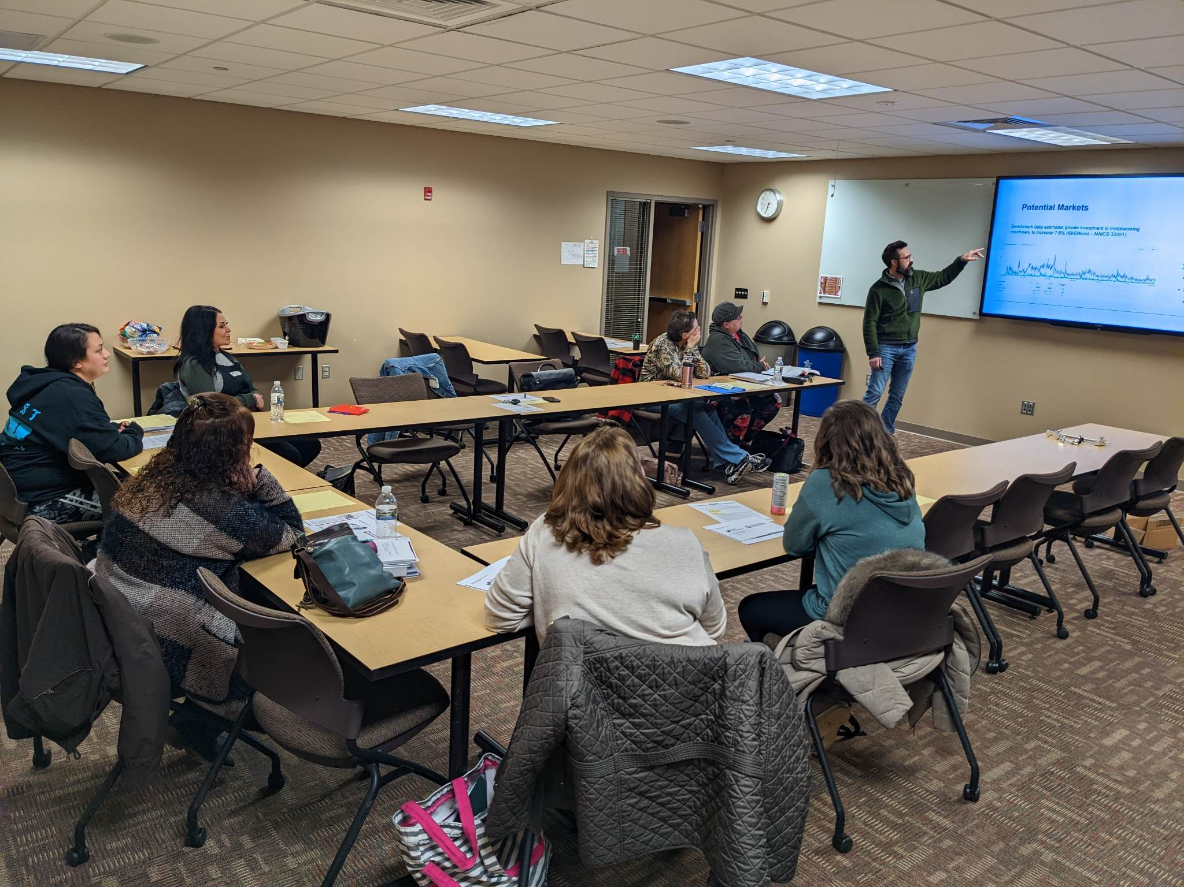
Small Business Development
Small business development focuses on the ecosystem that creates a positive local environment for new business growth and business retention grounded in rural realities. This may include projects that create more opportunities for access to capital for small businesses, training/mentoring programs, asset mapping, incubator development, etc.
WEDC Entrepreneurship Partners Grant (EPG)- Langlade County EDC
Langlade County Economic Development Corporation received an EPG to develop The Entrepreneurial Training Program which is a comprehensive set of resources and support for individuals at various stages of entrepreneurship.
Langlade County EDC Entrepreneurial Training Program
Notes:
EPG description from Langlade Co.: The Entrepreneurial Training Program offers a comprehensive set of resources and support for individuals at various stages of entrepreneurship. It includes a 9-week Business Plan Series with instruction, guest speakers, and counseling for those considering starting, struggling with, or looking to grow their businesses. The Business Education Series provides both in-person and online learning options, covering essential aspects of business management such as accounting, budgeting, QuickBooks usage, e-commerce, and social media marketing. Additionally, there's a Swipe Smart Workshop to educate businesses on card processing systems. The program includes quarterly Peer Mentoring Groups and One-on-One Counseling Services.
WEDC: Capital Catalyst? EPG, others.....

Slide 9
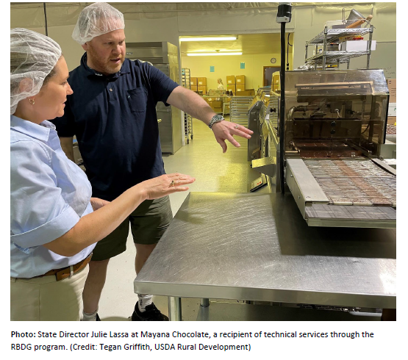
Program: Rural Business Development Grant (RBDG)
Small Business Project Description: The most recent obligation of a $55,000 RBDG to Wisconsin Business Innovation Corporation (Northwest Regional Planning Commission) is being used to provide technical assistance to small and emerging businesses in northwest Wisconsin. The project will assist five businesses and create or save 52 jobs.
Notes:
EPG description from Langlade Co.: The Entrepreneurial Training Program offers a comprehensive set of resources and support for individuals at various stages of entrepreneurship. It includes a 9-week Business Plan Series with instruction, guest speakers, and counseling for those considering starting, struggling with, or looking to grow their businesses. The Business Education Series provides both in-person and online learning options, covering essential aspects of business management such as accounting, budgeting, QuickBooks usage, e-commerce, and social media marketing. Additionally, there's a Swipe Smart Workshop to educate businesses on card processing systems. The program includes quarterly Peer Mentoring Groups and One-on-One Counseling Services.

Slide 10
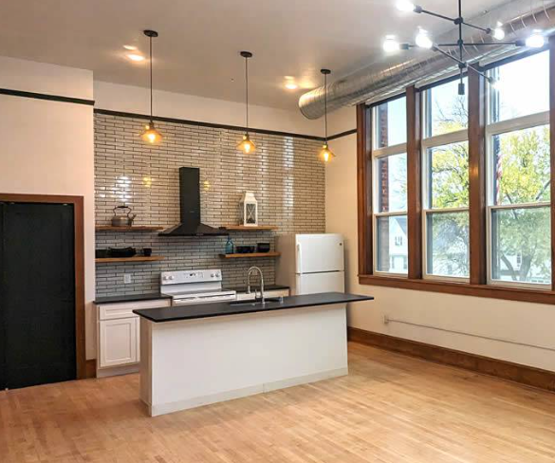
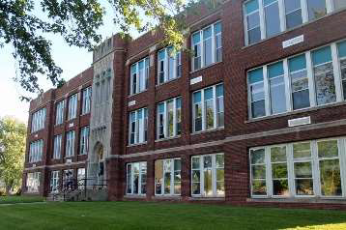
Rural Housing
Projects that make it easier for rural communities to develop single family or multi-family housing projects, rehab aging housing stock, or attract developers to their community.
WEDC Community Development Investment Grant
The Albrecht School Apartments, Mayville
After sitting vacant for more than 20 years, the City of Mayville received $250,000 in CDI funding to assist with the conversion of the downtown school into 22 apartments with a first-floor retail space. The new library is also being developed on a portion of the former playground.
Photos provided by Albrecht Apartments
Notes:
Might involve WICaP agency.

Slide 11
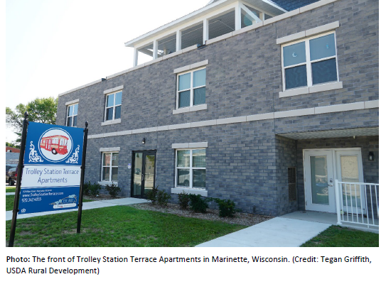
Program: USDA Rural Development Multi-Family Housing Loan Guarantee Program
Project Description: USDA Rural Development Multi-Family Housing Loan Guarantee Program provided $1.8 million in collaboration with Newcap Inc, Trolley Station Terrace, Hunt Capital Partners, WHEDA, Merchants Capitol Corp, WEDC to construct a 45-unit tax credit complex. The total project cost is upwards of $10 million and includes $6.3 million in Low Income Housing Tax Credits through WHEDA. The new, three-story building consists of 13 one-bedroom units, 25 two-bedroom units and seven three- bedroom units targeting residents of all ages. The housing units are furnished with energy efficient appliances and boast community amenities such as a fitness center, rooftop terrace, community room, playground, and an outdoor pet area.

Slide 12
Community Facilities
Examples of essential community facilities:
Health care facilities
Public facilities
Public safety services
Educational services such as museums, libraries or private schools
Local food systems organizations
USDA Community Facilities Direct Loans and Guaranteed Loans Program
The city of Baraboo used a $6,000,000 loan to construct an addition and make renovations to the Carnegie-Schadde Memorial Public Library. The city of Baraboo's existing library lacked adequate space to serve their service area, due to a fifty percent increase in population served and usage. The library was built in 1903 and no longer meets current codes, is expensive to maintain and lacks the quality technology and space to meet community needs. The building is a landmark in Baraboo, located in the historic downtown just a block off the "Square" and too valuable to vacate, therefore, many hours and great minds have worked on this project to preserve the historic facility but make the necessary expansions and additions to meet the growing needs of the community and staff of the library.
Prepared by USDA Rural Development, Wisconsin State Office
Photo Credit: Carnegie-Schadde Memorial Public Library

Slide 13
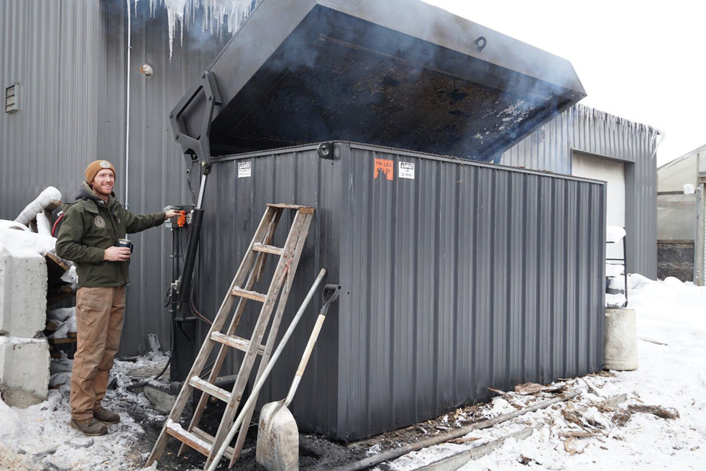
Priority Area: Sustainable Energy
Sustainable Energy project focus areas may include an acceleration of clean energy technology deployment, maximizing energy efficiency, modernization of buildings and local industries, or innovative transportation.
Program: Rural Energy for America Program (REAP) Renewable Energy and Energy Efficiency Loans and Grant Program
Project Description: Mill Creek Gardens LLC used a $20,000 REAP Grant to install a second biomass boiler. Mill Creek Gardens is a small home gardening business in Marshfield, Wisconsin. The new system is expected to save the company $9,836 per year. It will reduce electricity and natural gas usage. Mill Creek Gardens also used a $20,000 REAP Grant in 2017 to purchase and install a Heat Master Biomass Boiler.
Photo: Erik Winer with a new biomass boiler near the greenhouses it helps to heat. (Photo: Tegan Griffith, USDA Rural Development)
Notes:
https://osce.wi.gov/Pages/CleanEnergyPlan.aspx

Slide 14
Thrive Rural Wisconsin Benefits
A community assessment
Work plan development for priority projects
Project management support
Fundraising mapping and funding identification
Grant writing consulting (process guidance, review, etc.)
Creation of customized toolkits and resources to build capacity in grant writing, grant compliance, or Thrive Rural WI focus areas
Referrals to consultants, state agencies, and federal programs that help advance the projects identified in the work plan
Exclusive invitation to apply for predevelopment grants (of up to $25,000 per year for up to two years)

Slide 15
Thrive Rural Wisconsin Grants
Communities selected for the Thrive Rural WI technical assistance will receive an invitation to apply for predevelopment grants (of up to $25,000 per year for up to two years).
Eligibility: The applicant may be any eligible entity within the leadership team. Eligible entities are local economic development organizations, units of government and/or tribal communities.
Grant uses: To advance a project and prepare for state and federal grant applications. Professional fees may include:
Feasibility or engineering studies
Architectural/design renderings
Mapping and planning
Curriculum design
Legal or financial consultants
Ineligible uses: Construction costs, past costs, in kind staffing

Slide 16
How to apply for technical assistance:
Two step process:
Submit Community Interest Form
Email Attachments to ThriveRuralWI@wedc.org
To be eligible for review both steps
must be completed by
January 16, 2024 at 11:59pm.

Slide 17
Step 1: Submit Community Interest Form
Request for Technical Assistance (25 points) What community economic development challenges are you looking to understand and address within the Thrive Rural Wisconsin focus areas? In describing the current community economic development challenges in your area, please also briefly describe what has been done to date to understand and address the situation identified.
Goals (25 points) What are you hoping to achieve being part of this pilot project?
Leadership Team (20 points) Please share an overview of the local leadership team that will support comprehensive economic analysis and planning efforts. How does the leadership team reflect the project areas and communities the work will take place in? Please upload a list of leadership team members and bios at the end of the application.
Commitment (10points) What time commitment are you and your team willing to put towards the successful completion of this project? This includes regular meetings with your Rural Development Specialist and time for trainings and events that advance the goals of the project areas identified.
Collaboration (10 points)In what ways do you envision partnering with Regional Economic Development Organizations (REDOs), Regional Planning Commissions (RPCs), UW-Extension, or the Great Lakes Inter Tribal Council (GLITC) for additional resources or support on these projects? What programs or resources would be helpful to learn more about?

Slide 18
Step 2: Submit Attachments
All attachments must be emailed to ThriveRuralWI@wedc.org when the interest form is submitted.
Required attachments
Leadership Bios and Roles
Letters of support from participating local municipalities/partners
Other supporting documentation
Strategic planning documents
Additional supporting documents
Remember!
The more documentation you are able to provide, the stronger your submission will be!

Slide 19
What makes a
strong application?
A strong case of the issues or priorities you want to address. What and why now?
Clear goals and some initial projects you want to move forward.
Team reflects collaboration, includes technical expertise and decision-making ability to move municipal/county projects forward.
Time committed to working with a
Rural Development Specialist over two years
and apply for state and federal funding
opportunities.
Existing collaboration with regional, statewide, and federal partners or strong interest in collaboration with specific interests.
Criteria | Maximum Points
Request for Technical Assistance | 25
Goals | 25
Leadership Team | 20
Commitment | 10
Collaboration | 10
Distressed County | 10

Slide 20
Commitment
What is expected of selected communities:
Identify priority projects
Communities should plan to collaborate with ORP Rural Development Specialists approximately 2-3 hours per week on the proposed projects.
Prepare for applying for state, federal, and philanthropic funding
Develop a workplan approximately 22 months in duration

Slide 21
Application Timeline:
Community Interest Form and Attachments Due: January 16th, 11:59pm
Selection notifications will be made on February 2nd
What to expect if you are selected:
February 2024: Onboarding, Assessment, and Work Plan Development
March 2024: Priority projects identified and work plan finalized.
April 1, 2024: Deadline to apply for Thrive Rural Grant
April – December 2024: Project management to implement grant and move forward key components of the work plans. Various trainings and meetings that support work plan. Prepare applications for other state and federal funding when applicable.
December 2024: Community debrief and initiate 2025 work planning process

Slide 22
Questions?

Slide 23
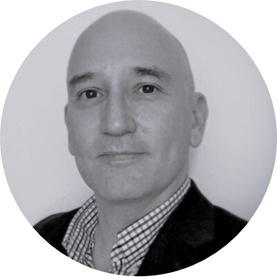
Project-specific questions? Reach out to us!
Beth Haskovec
Office of Rural Prosperity Director
Beth.Haskovec@wedc.org
David Fleming
Rural Development Specialist
David.Fleming@wedc.org

Slide 24
Thank you!
Please remember to sign up for our newsletter for the latest updates and news for Rural Wisconsin!
ruralwi.com/stay-connected/

