Slide 1
Thrive Rural Wisconsin
Informational Webinar
Oct. 14, 2025

Slide 2


Slide 3
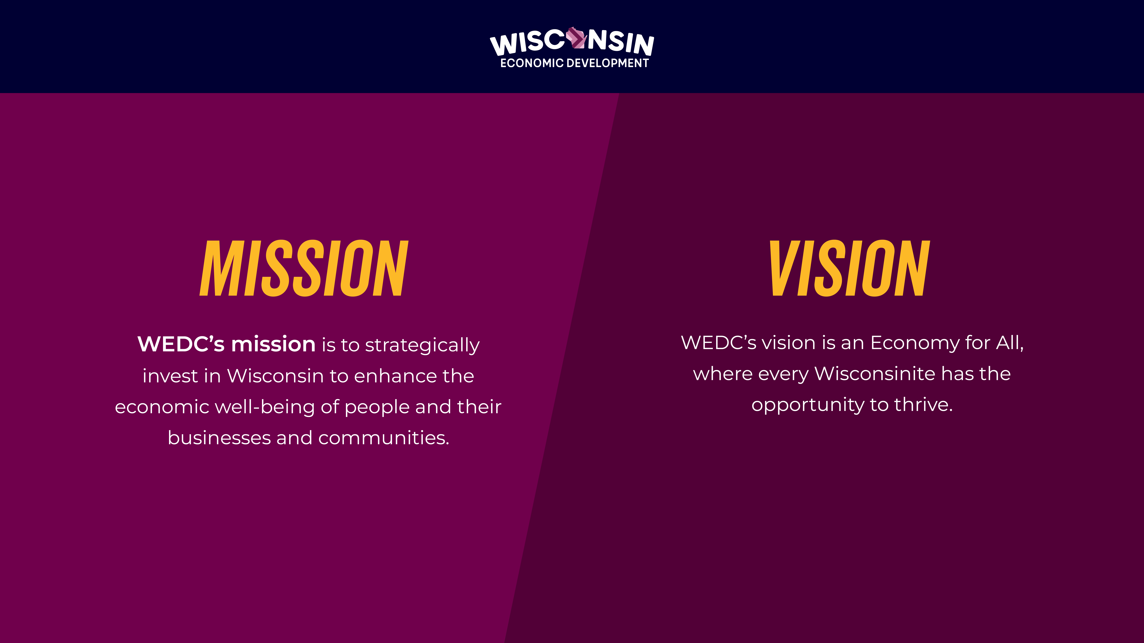

Slide 4
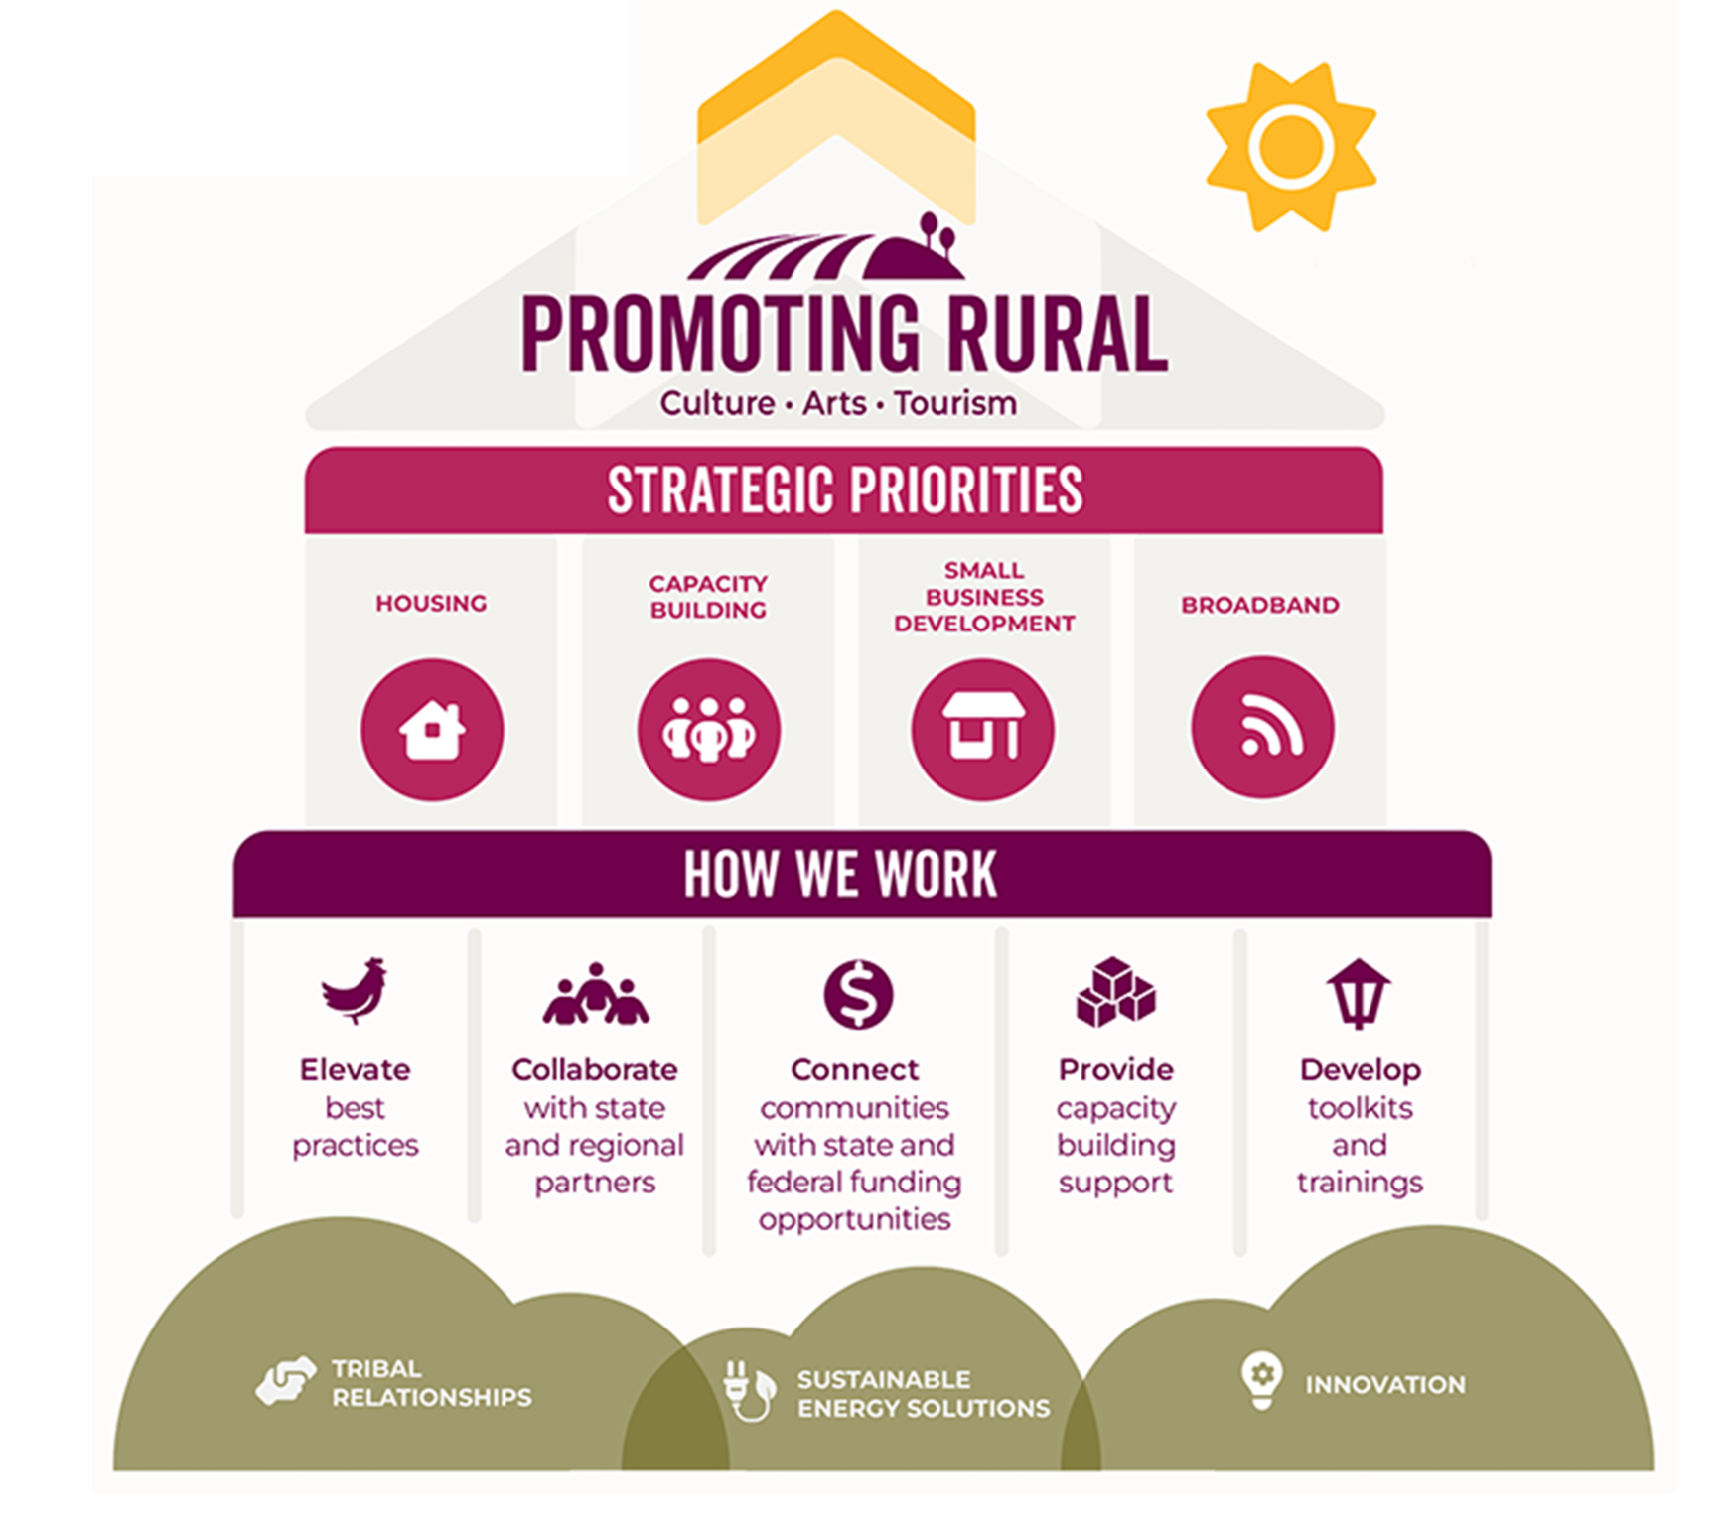
Office of Rural Prosperity Strategic Priorities

Slide 5
Thrive Rural Wisconsin
Todays Agenda
40 minutes presentation on Thrive Rural Wisconsin
Program information
Eligibility and submission process
Technical and Financial Assistance information
20 minutes Question and Answer
During the presentation you may type your questions in the chat

Slide 6
Thrive Rural Wisconsin
Thrive Rural Wisconsin program brings project management, financial support, and technical assistance to advance local and regional initiatives and connects them to the resources they need to be successful.
Opportunity to build collaboration between local economic development partners to achieve common goals.
Strengthen financial and organizational policies and procedures to accept and report on state & federal funding.

Slide 7
Eligibility for Technical Assistance
County economic development organizations
Nonprofits
Tribal organizations
Based in communities of 10,000 people or fewer are eligible to apply for the Thrive Rural Wisconsin initiative, so long as they are not located in a county that contains a Metropolitan Statistical Area (i.e., an urban area of 50,000 or more inhabitants).
The selection process will give priority to Rural communities and organizations located in a county that appears on the FY26 Wisconsin Distressed Counties List.

Slide 8
Priority Areas
Communities must propose a project that advances at least one of the Thrive Rural Wisconsin focus areas:
Rural Housing
Projects that make it easier for rural communities to develop single family or multi-family housing projects, rehab aging housing stock, or attract developers to their community.
Community Based Economic Development
Economic development that prioritizes economic well-being and quality of life in a community. This approach engages community members in identifying issues and creating solutions the improve the vibrancy of their communities.

Slide 9
Priority Areas
Small Business Development Projects and Programs
Small business development focuses on the ecosystem that creates a positive local environment for new business growth and business retention grounded in rural realities. This may include projects that create more opportunities for access to capital for small businesses, training/mentoring programs, asset mapping, incubator development, etc.
Regional Collaboration Initiatives Development
The process of creating and strengthening partnerships among rural communities, organizations, governmental units and businesses to share resources, address common challenges, and pursue opportunities for economic, social and environmental improvement.

Slide 10
Priority Areas
Rural Capacity Development & Growth
The ability of rural communities to leverage their people, institutions, infrastructure, and natural resources to meet the present needs, while expanding population, economy, and quality of life in a sustainable way.
As part of Capacity Building, a primary outcome of the Thrive Rural WI program is to prepare communities to apply for and receive federal and state grants. Additionally, local funding such as TIF will be explored to advance community projects.

Slide 11
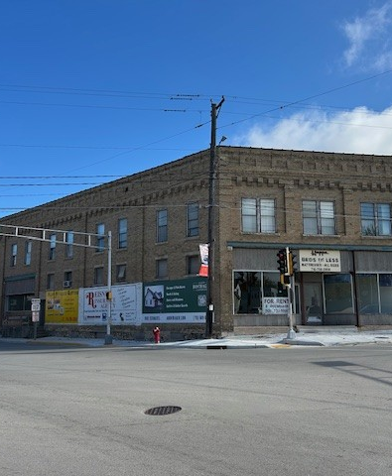
Long Lasting Community Based Economic Development
Village of Bonduel
Partnership with Shawano County Economic Progress, local school district, chamber, business community
2 projects: Housing and Revitalize Downtown
Thrive Rural's impact:
Provided funding to help with legal fees on removing restrictive covenants for housing.
7 lots under contract or under construction
Additional 48-unit complex has started
Funded the creation of an RDA.
17 current vacant buildings
Received a $100,000 SBDG grant from WEDC. Used to fund façade work.
Currently a consultant is working on the Redevelopment plan
The Thrive Rural WI program has provided Technical Assistance that assisted with Developer Agreement drafting, consultation on TID and referrals to Connect Communities.
Photo: Vacant, high priority building in downtown Bonduel

Slide 12
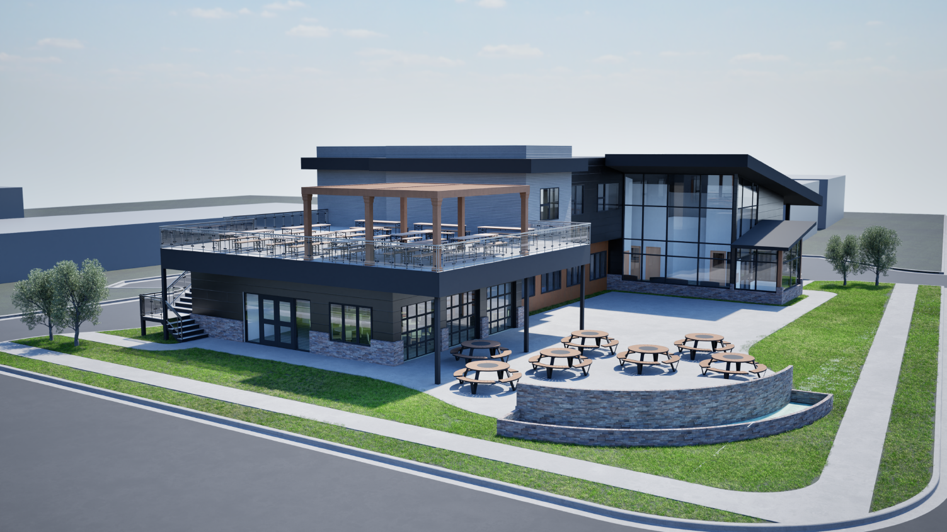
Providing Lasting Support for Small Business Development
Wood County: City of Pittsville
Pittsville is taking a major step toward strengthening its community by establishing a nonprofit organization focused on outdoor recreation, business development, and housing.
At the heart of this initiative is the creation of a multipurpose building in downtown Pittsville that will serve as a vibrant community hub. This space will support a range of uses, including community events, business incubation, rental opportunities, and housing.
Thrive Rural WI has provided Technical Assistance that assisted with consultant review, project timeline structure and referrals to funding resources.
Photo: Rendering of the Cran City Corner multipurpose building​
12

Slide 13
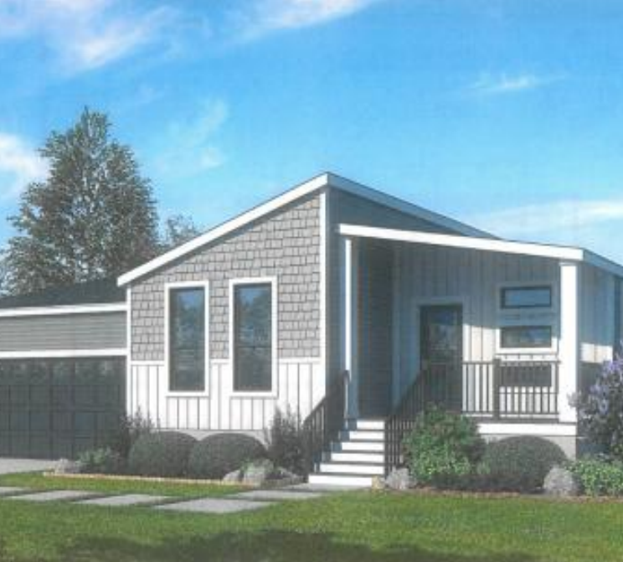
Regional Collaboration
A partnership consisting of Southwestern Wisconsin Community Action Program, Inc. (SWCAP), Southwestern Wisconsin Regional Planning Commission and Skyline Homes
Provide affordable housing on infill lots.
SWCAP has taken on the role of developer as a non-profit to reduce cost of homes provided by Skyline Homes.
This savings is then passed on to the end buyer of the home to provide a new and innovative way that brings cost of home ownership down.
Truly a win-win-win for southwestern Wisconsin.
Note: This example is not a Thrive Rural WI project. However, it provides an example of a strong regional collaboration effort to address a regional need.
Image provided by Southwestern Wisconsin Regional Planning Commission
Notes:
Might involve WICaP agency.

Slide 14
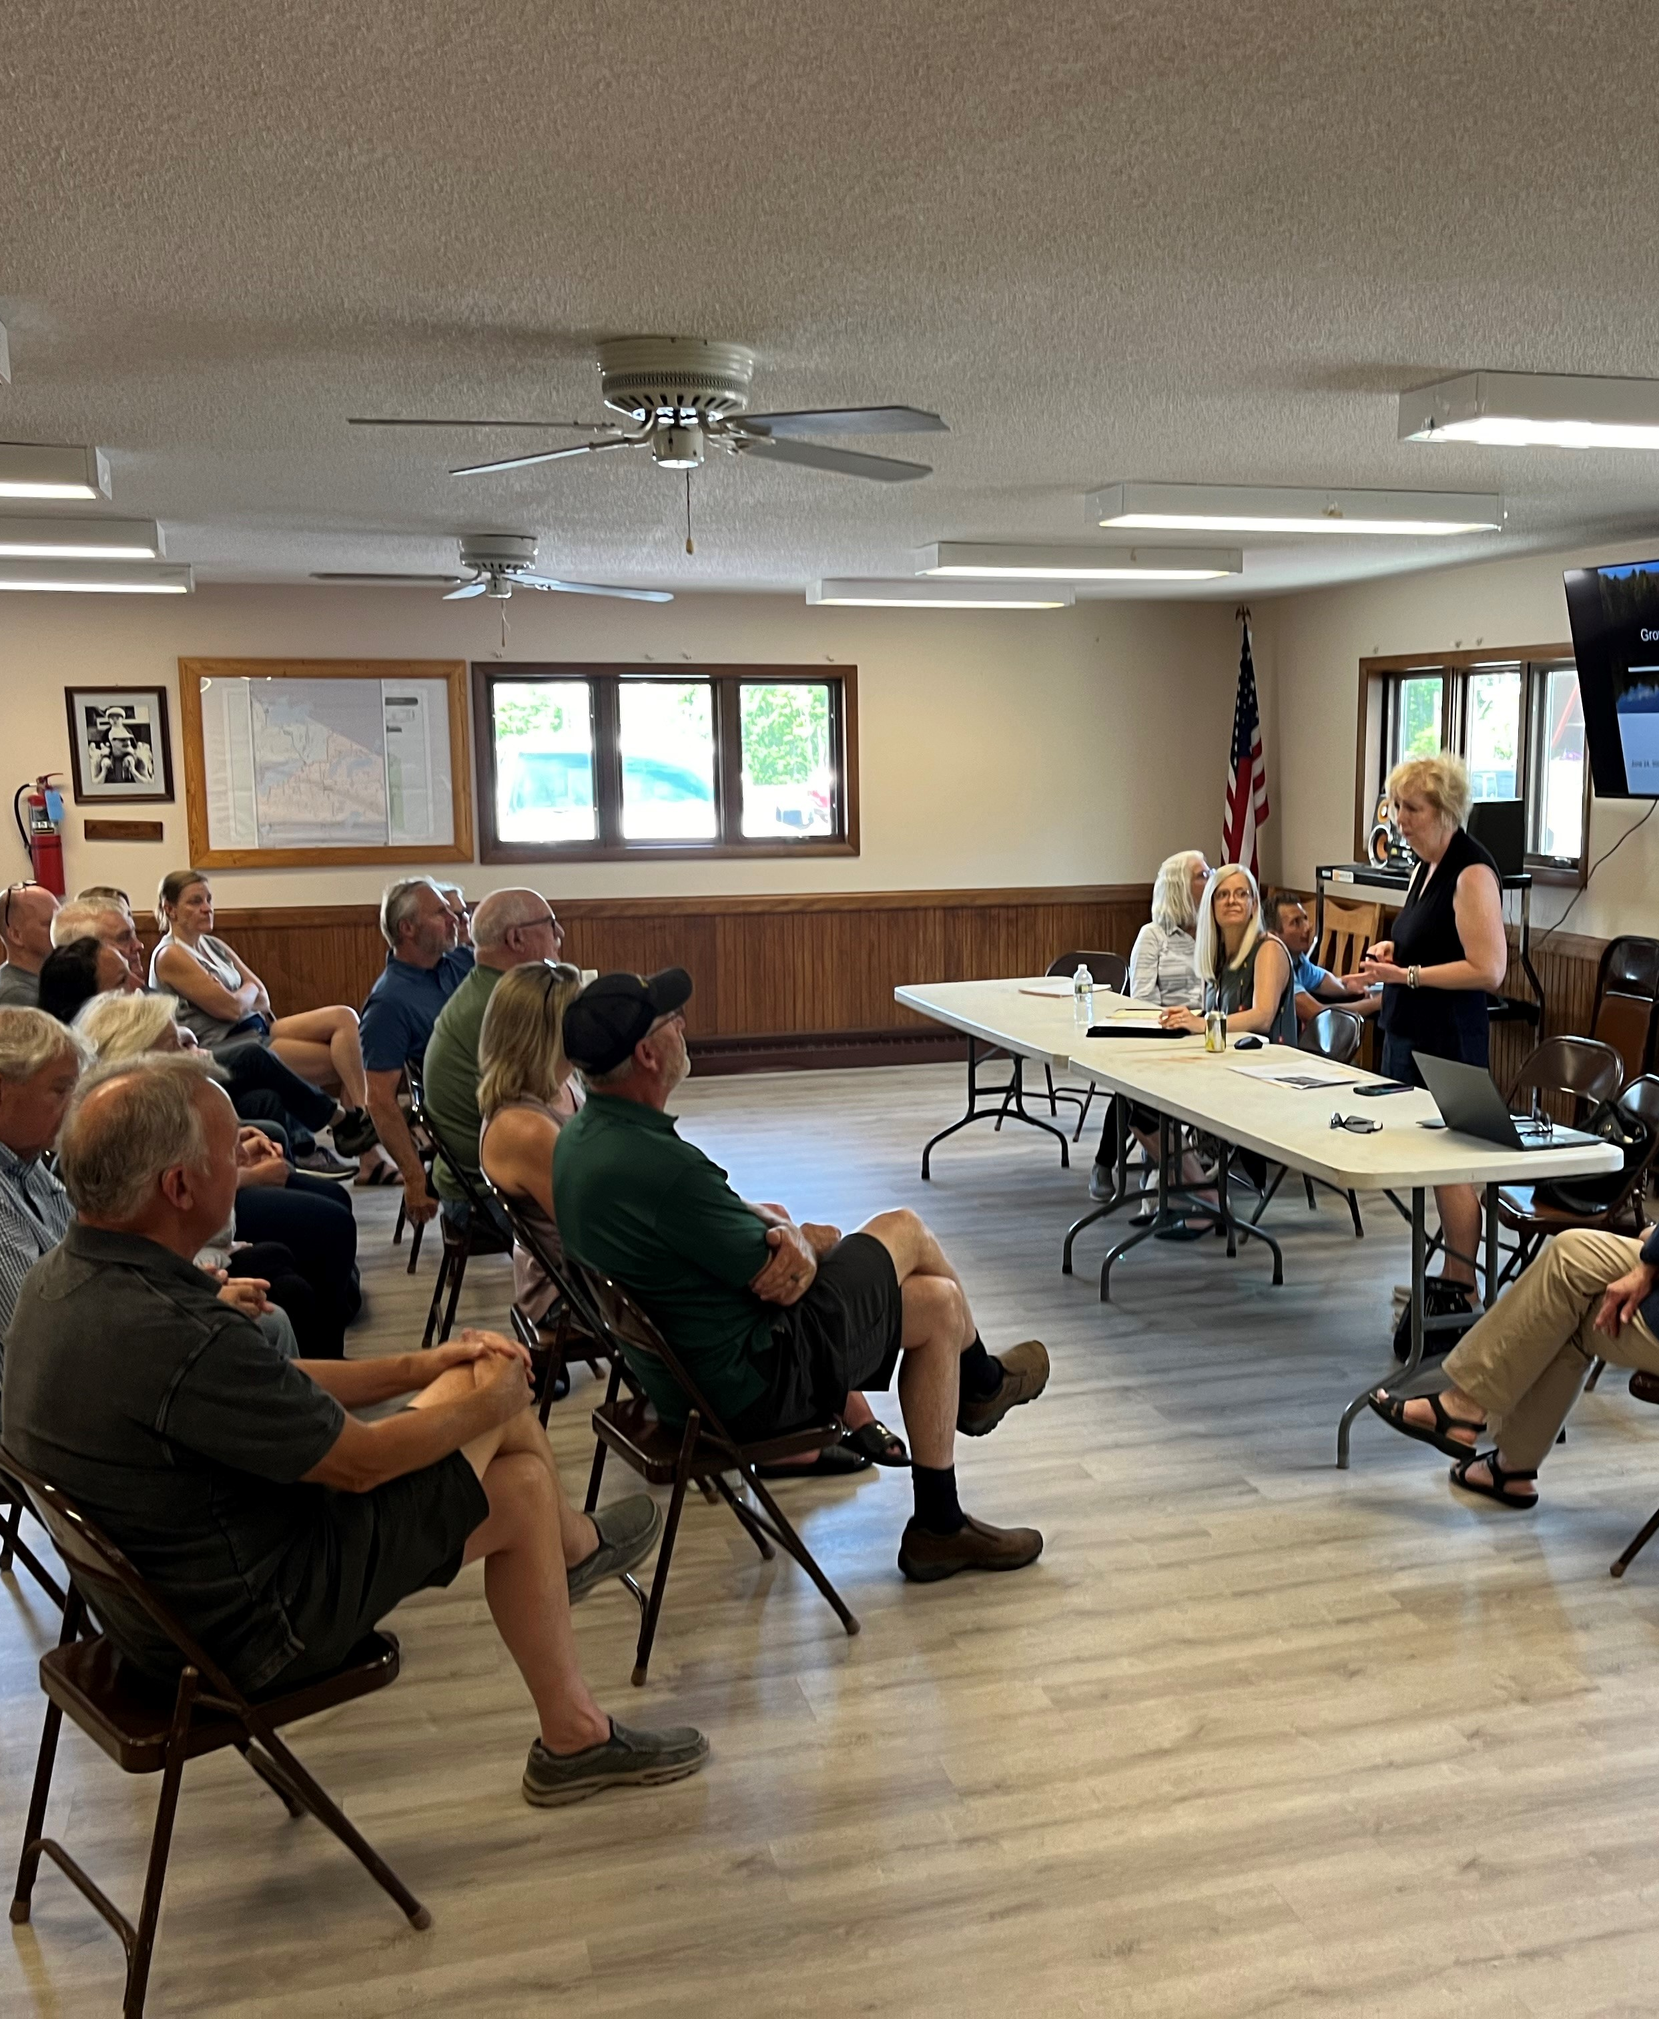
Thrive Rural Wisconsin Benefits
A community assessment
Work plan development for priority projects
Project management support
Fundraising mapping and funding identification
Grant writing consulting (process guidance, review, etc.)
Creation of customized toolkits and resources to build capacity in grant writing, grant compliance, or Thrive Rural WI focus areas
Referrals to consultants, state agencies, and federal programs that help advance the projects identified in the work plan
Exclusive invitation to apply for predevelopment grants (of up to $25,000 per year for up to two years)
Photo: Consultant-led Community Focus Group

Slide 15
WEDC Capacity Building Grants
Communities selected for the Thrive Rural WI technical assistance will receive an invitation to apply for predevelopment grants (of up to $25,000 per year for up to two years).
Grant uses: To advance a project and prepare for state and federal grant applications. Professional fees may include:
Feasibility or engineering studies
Architectural/design renderings
Mapping and planning
Curriculum design
Legal or financial consultants
Ineligible uses: Construction costs, past costs, in kind staffing

Slide 16
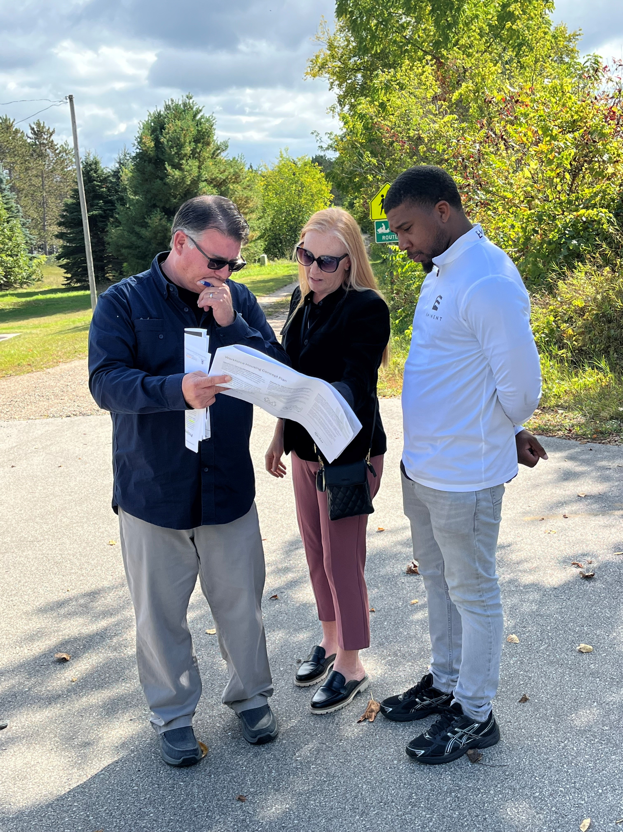
How to apply for technical assistance
Submit community interest form online
Submit attachments to: ThriveRuralWI@wedc.org
To be eligible for review both steps must be completed by Nov. 13, 2025, at 5:00pm.
Photo: Sara Pullen, Village of Wausaukee discusses the proposed site plan with Eric Fowle from Cedar Corp and Julian Walters from Eminent Development Corp.

Slide 17

Required and Supporting Documentation
All attachments must be emailed to ThriveRuralWI@wedc.org when the interest form is submitted.
Required attachments
Leadership bios and roles
Letters of support from participating local municipalities/partners
Other supporting documentation
Strategic planning documents
Additional supporting documents
Remember!
The more documentation you are able to provide, the stronger your submission will be!

Slide 18

What makes a strong application?
Criteria | Maximum Points
Request for Technical Assistance | 25
Goals | 25
Leadership Team | 20
Commitment | 10
Collaboration | 10
Distressed County | 10
A strong case of the issues or priorities you want to address. What and why now?
Clear goals and some initial projects you want to move forward.
Team reflects collaboration, includes technical expertise and decision-making ability to move municipal/county projects forward.
Time committed to working with a Rural Development Specialist over two years and apply for state and federal funding opportunities.
Existing collaboration with regional, statewide, and federal partners or strong interest in collaboration with specific interests.

Slide 19
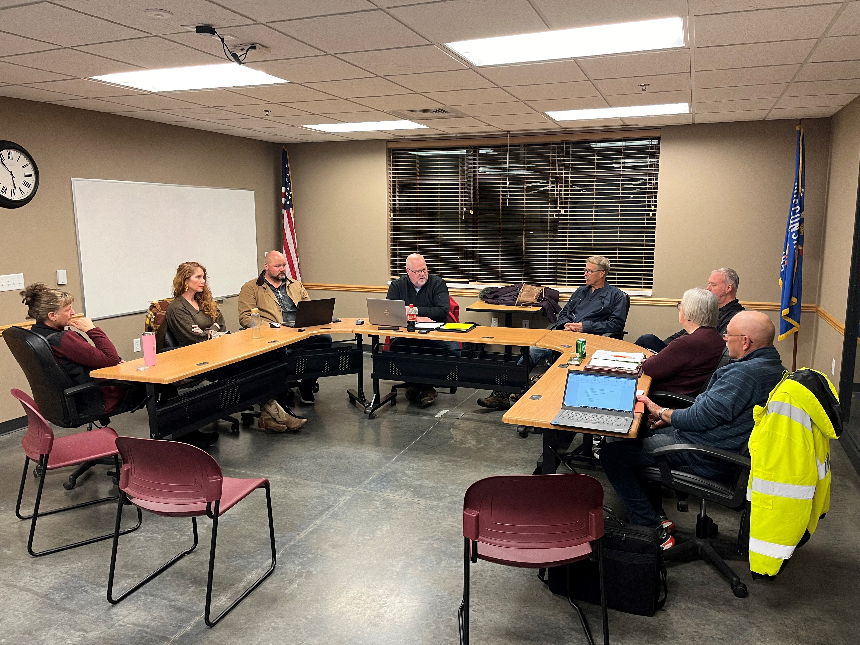
Commitment
What is expected of selected communities:
Identify priority projects
Regular and consistent engagement of the Leadership Team
Communities should plan to collaborate with ORP Rural Development Specialists on average approximately 2-3 hours per week on the proposed projects.
Prepare for applying for state, federal, and philanthropic funding
Develop a workplan approximately 23 months in duration
Strong relationship amongst local communities and existing initiatives between counties/municipalities/ towns, etc.
Build off existing plans.
A willingness to expand relationships and collaborations.
Photo: Gays Mills Leadership Team meeting with Vierbicher Consulting for a status update

Slide 20
Application Timeline
Community Interest Form and Attachments Due: Nov. 13th, 5:00pm
Selection notifications will be made by Dec. 31st
What to expect if you are selected:
Jan. 2026: Onboarding, Assessment, and Work Plan Development
Feb. 2026: Priority projects identified and work plan finalized.
April 1, 2026: Deadline to apply for WEDC Capacity Building Grant
April–Dec. 2026: Project management to implement grant and move forward key components of the work plans. Various trainings and meetings that support work plan. Prepare applications for other state and federal funding when applicable.
Dec. 2026: Community debrief and initiate 2027 work planning process

Slide 21
Questions?

Slide 22

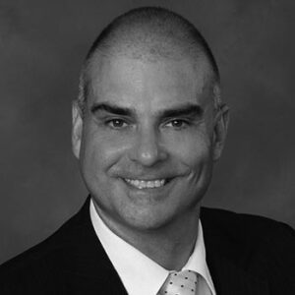
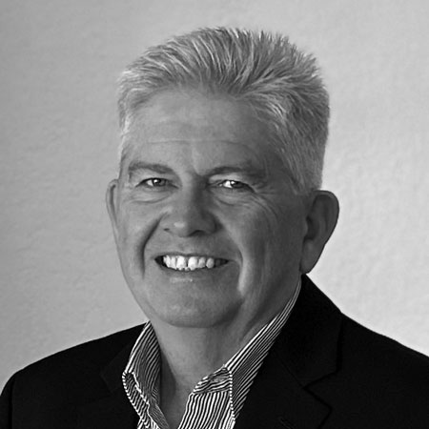
Project-specific questions?
Reach out to us!
Beth Haskovec
Office of Rural Prosperity Senior Director
Beth.Haskovec@wedc.org
James Cleveland
Rural Development Specialist
James.cleveland@wedc.org
Paul O’Connor
Rural Development Specialist
Paul.oconnor@wedc.org

Slide 23

Thank you!
Please remember to sign up for our newsletter for the latest updates and news for Rural Wisconsin!
ruralwi.com/stay-connected
or
scan the QR code with your phone camera

